Slide 1
Python for Healthcare Modeling and Data Science

Slide 3
What is Data Science

Slide 4

What is Data Science?
Data science is a field of study that involves using data to gain insights and knowledge about a particular topic or problem. It combines elements of statistics, computer science, and domain expertise to analyze and interpret data.
The main goal of data science is to extract useful information from large datasets and use this information to solve problems or make decisions. This can involve creating predictive models, identifying patterns and trends, or performing data visualization to better understand complex data.
In essence, data science helps us make sense of the vast amount of data that we have access to in today's world, and helps us make better decisions based on this information.

Slide 5
Aspects of data science
Data Collection
Data Cleaning
Data Analysis
Data Visualization
Machine Learning
Communication
Notes:
Data Collection: This involves gathering data from various sources such as databases, APIs, surveys, sensors, social media, and other relevant sources.
Data Cleaning: This is the process of ensuring that the data is accurate, complete, and ready for analysis. It involves tasks such as removing duplicates, dealing with missing values, and correcting errors.
Data Analysis: This is where data science really comes into play. The data is analyzed using statistical techniques, machine learning algorithms, and data visualization tools to gain insights and extract meaning from the data.
Data Visualization: This aspect of data science involves creating charts, graphs, and other visual representations of the data to make it easier to understand and communicate the findings to others.
Machine Learning: This is a subfield of data science that involves building models that can learn from data and make predictions or decisions based on that learning.
Communication: Finally, data science requires effective communication skills to be able to present the findings to stakeholders and decision-makers in a way that is easy to understand and actionable.

Slide 6
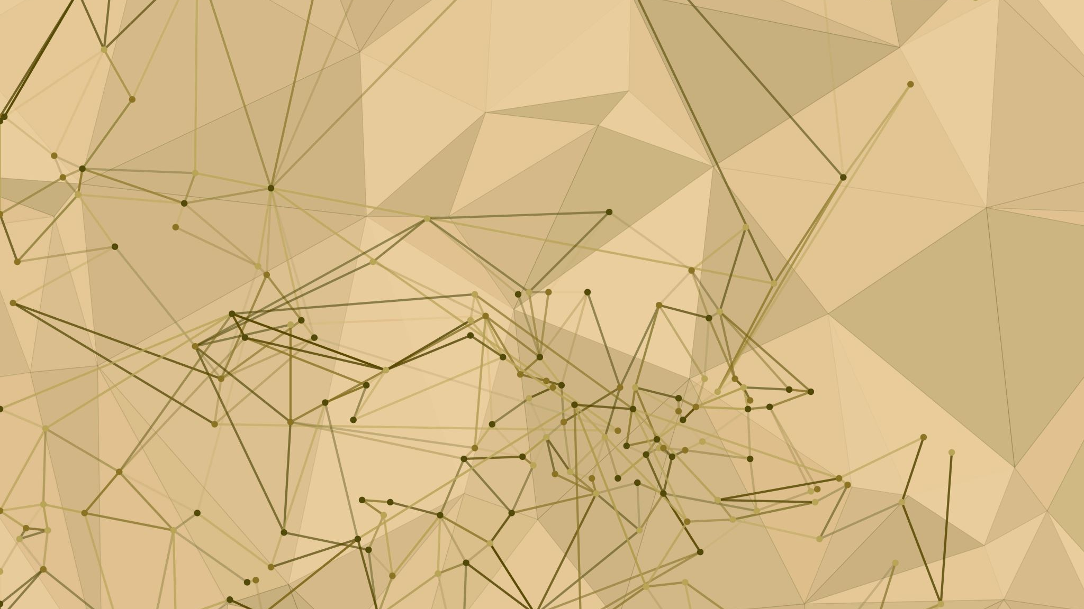
Importance of Data science in the medical field

Slide 7

Data science and medical industry
Data science is becoming increasingly important in the medical industry due to the large amounts of data generated by electronic health records, medical devices, and clinical trials. Here are some key reasons why data science is important in the medical industry:
Predictive modelling: Data science allows medical professionals to use machine learning algorithms to predict disease progression, identify at-risk patients, and personalize treatments based on individual patient characteristics.
Precision medicine: Data science enables researchers to analyze genomic data and develop targeted therapies for specific genetic mutations. This approach to medicine can lead to more effective treatments with fewer side effects.
Clinical trials: Data science can help researchers design and conduct more efficient and effective clinical trials, leading to faster drug development and approval.
Patient outcomes: By analyzing large datasets, data science can help medical professionals identify trends in patient outcomes, leading to improved treatment plans and better overall care.
Public health: Data science can be used to analyze population-level health data, identify disease prevalence trends, and develop disease prevention and control strategies.

Slide 8
Examples of Data Science in the medical field
Data Analysis:
Analyzing electronic health records (EHR) to identify disease patterns, trends and risk factors
Analyzing clinical trial data to assess the effectiveness of new treatments
Analyzing epidemiological data to track the spread of diseases
Image Analysis:
Analyzing medical images such as X-rays, MRIs, and CT scans to detect abnormalities
Identifying tumours, lesions, and other abnormalities in medical images using machine learning algorithms
Tracking the progression of diseases by analyzing images over time
Machine Learning:
Developing predictive models to identify patients at risk of developing certain conditions such as diabetes, cardiovascular disease, or cancer
Developing algorithms to assist with clinical decision-making, such as identifying the best treatment options for patients based on their medical history and symptoms
Developing diagnostic tools using machine learning algorithms that can automatically identify certain diseases from medical images or patient data
Natural Language Processing (NLP):
Analyzing unstructured clinical notes and medical records to extract useful information such as diagnoses, treatments, and medication dosages
Developing chatbots or virtual assistants that can answer patient questions or provide medical advice
Develop algorithms that can classify medical texts, such as medical publications or clinical guidelines, into different categories or topics.

Slide 9
Diabetic Retinopathy case-study
Gulshan and Peng et al 2016 JAMA

